Slide 1
Investigative Assignment
To: Field Reporting Department FROM: Executive Producer of
Names of Reporters on the Team: National Geographic
WHAT: National Geographic wants to dispatch your team on a special assignment for the next two weeks to investigate a story. You will conduct research and produce a 15 minute segment for a live broadcast. (week three) .
Pre-Research PROPOSAL: Your team will do preliminary research, then as a group decide on your topic and how you will develop it, prepare a plan and assign roles(Day 1).
RESEARCH In-depth: Next you will work on in-depth research using a variety of quality resources. (Day 2-6).
PRESENTATION PREP: Complete remaining research, compile it, and practice for a “TV News” live broadcast (Day 7-9).
Live PRESENTATION: You will present to others, and listen to other broadcasts (taking notes on other presenters) (Day 10-14)

Slide 2
Pre Research Proposal
DAY ONE: Do some preliminary brainstorming…discussion & research on your topic to develop an angle and approach to your topic. Choose a team leader to who will help keep everyone on task, stay organized and be a diplomatic communicator.
SUBMIT YOUR PROPOSAL: Make a plan for how you will develop your story and divide up the work. You may want to include an interview [live skit] or a short moderated debate between two sides of the topic, or an undercover report from the field [live skit] (HINT: Take a look at the end PRESENTATION format and OPTIONS to make your plan.) Be sure you get the OK from Executive Producer (teacher) so that you are on the right track. Use this format for the proposal:
TOPIC: APPROACH & ASPECTS to develop: ROLES: (name + job/tasks)
TEAM CAPTAIN:

Slide 3
Research In-Depth
Next you will work on in-depth research using a variety of quality resources. As a team
you must ensure high journalistic standards by using QUALITY sources and as a team
check that the information you have is accurate. (Day 2-6) Use GOOGLE DOCS as a
collaborative space and be sure to invite your teacher and librarian to help you in research.
DAY TWO - SIX: Each team member will have a responsibility to use quality resources to uncover detail about their part of the project. They MUST cite their sources so others can also help evaluate the quality. And remember, no “copy-paste” research!
COLLABORATION: Use Google Documents to share your research and collaborate. Be sure to have a Research page to collect website addresses and book titles (and authors) of source material. Also, use this document to take notes in your own words of the information. SHARE this Google doc with your teacher and Ms. Deaton.
EVALUATION & ORGANIZATION of INFORMATION: BE CREATIVE and think of ways to get the information out, and keep it interesting and entertaining. Be aware that you will have to share time among your group for the presentation, so each person will get enough time to do their part (and not go overtime).
SUBMIT on Day 6: The group should present their written research to the Exec Producer (teacher) with each person’s name on their portion of research. It should be in the order that you plan to present it. You will be GRADED for your research as individuals and given advice and feedback by the Exec. Producer to incorporate into final presentation.

Slide 4
Presentation Prep
Compile your research into a TV News Broadcast presentation. (Day 6-9)
PRACTICE YOUR PART before the broadcast as it will be presented LIVE!
WARNING: KEEP THE TECHNOLOGY SIMPLE… (i.e. Powerpoint slides) All of your research and building content has to come FIRST, then work with the presentation.
SCRIPT & ROLES: Organize how you will present and be sure everyone has a role:
Possible Roles: News Anchors, Reporters who specialize in particular topics (i.e. weatherman, investigative journalist, interviewer, role play a famous person to be interviewed) It is possible that some people may have more than one role. [Check with the Exec (teacher) for specific formats that s/he requires.]
PROPS : Powerpoint Slides will be used as background images for the live presentation (at end). Do NOT put your script in the slides that appear in your program (you may however use note cards or a laptop as a teleprompter.)
OPENING Slide: Name of the program with a graphic or photo that reflects the topic and names of the anchor-people.
Each section of your program will have new slides with the names of the reporter and a newsy description of that segment. (ex. “Breaking News”, “Weather” In the case of the weather segment…you should have extra slides for maps, temps, forecast etc. ) Consider using Google Earth to zoom into your location… but be sure you have a backup system in case our network is not working…. Saving your slides in Powerpoint or downloading a Prezi is a fail safe way
On Location Slides: Use a realistic looking location slide for any portion of the program where you are reporting “On Location”
CREDITS Slide: include your research sources.
OTHER PROPS: You can include other programs (Prezi, imovie) and other props too. Be careful and get advice from your teacher and librarian about the technology you want to use as we want you to deliver a great product.
*OPTIONS??? Quiz In the wrapup of the program, do a quick 4-5 question Quiz that captures the main facts that student audience can answer on paper and add to notes. Quiz questions from all teams can be compiled for a final Class quiz at end for all.
**Done early??? Make a commercial break! For a little extra fun, make a fun and clever connection to the story inside a commercial.

Slide 5
LIVE Presentation
You will be evaluated through the process of this assignment (including
individually) on research but the team will also be evaluated for the success
of their final program, including the possibility of receive added bonuses for
exceptional work. In addition to being responsible for your own presentation,
each individual will be responsible for taking notes on the others presentations.
RUBRIC-REQUIREMENTS: teacher’s requirement for the assignment including:
Well rehearsed & timed
Well researched (and documented)
Well organized (engaging and original writing)
Well executed (great background slides and presentation)
OPTIONS for the Exec (teacher) to consider for the assignment
Click World to return to Main Menu

Slide 6
Options & Angles
DISPATCH From: could be CNN, Science Now, or any other real or imagined broadcast…. With a focus on your subject area.
FOCUS on Current Event: subdivide into news sections like these: A) Overview of the current event B) historical and cultural context, C) in the field reporting D) interview or debate in studio
E) Wrap up and Closing*
FOCUS on a specific country or region: subdivide into news sections like these: A) weather/geography B) current issues C) spotlight on a famous person D) spotlight on cultural tradition
E) Wrap up and Closing*
*QUIZ Section: Each group prepare a wrap-up quiz to hit highlights of their presentation. [Could be done on paper, with prompts at end of their program.] All quiz questions compiled and a final Quiz for all can be given to entire class.
**EXTRA: If the group is done with the requirements, they can create a fun commercial that includes some connections to the topic.
Click World to return to Main Menu

Slide 7
Anchor John Davis
Anchor Pam Sullivan

Slide 8
Use these sample background
slides for your broadcast.
Change out the images, and
names.
Don’t forget: Include a credit page at to cite the source info for your broadcast.
GUEST: insert your name here Political Analyst

Slide 9
Meteorologist Georgia Brown Weather

Slide 10
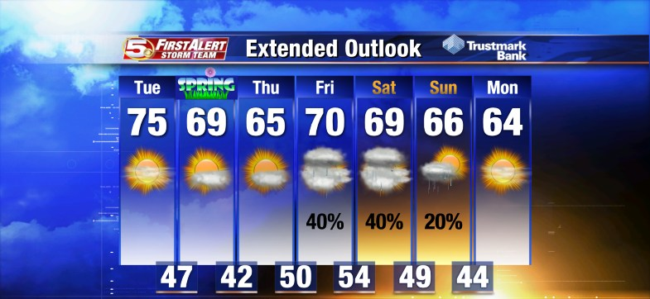
Meteorologist Georgia Brown Weather Forecast

Slide 11
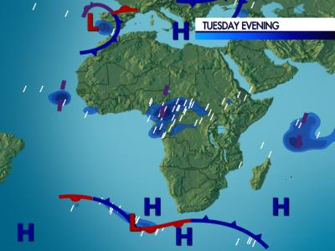
Meteorologist Georgia Brown Weather Forecast

Slide 12
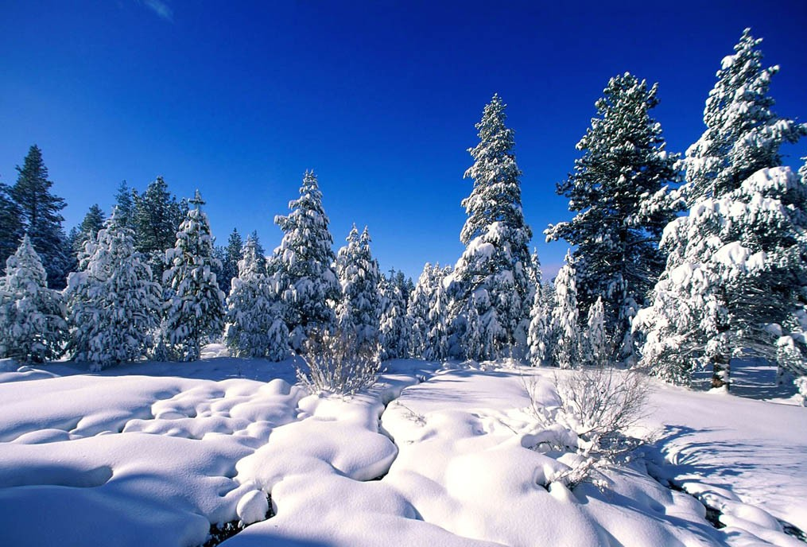
Field Reporter Jason Smith REPORTING LIVE from Mt. Washington

Slide 13
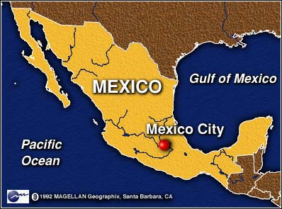
Field Reporter Jason Smith REPORTING LIVE from Mexico City

Slide 14
Field Reporter Jason Smith REPORTING LIVE from PARIS

Slide 15
Field Reporter Jason Smith REPORTING LIVE from Barcelona

