Slide 1
Watch the following short presentation.
Take note of mistakes that were made in its creation
What advice would you give
to improve the presentation?

Slide 2
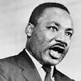
Martan Luther King Jr.

Slide 3
Martin Luther King, Jr. (January 15, 1929 – April 4, 1968) was an American clergyman, activist, and prominent leader in the African-American Civil Rights Movement.^{[1]} He is best known for his role in the advancement of civil rights in the United States and around the world, using nonviolent methods following the teachings of Mahatma Gandhi.^{[2]} King has become a national icon in the history of modern American liberalism.^{[3]}

Slide 4
A Baptist minister, King became a civil rights activist early in his career.^{[4]}
He led the 1955 Montgomery Bus Boycott and helped found the Southern Christian Leadership Conference (SCLC) in 1957, serving as its first president.
King's efforts led to the 1963 March on Washington, where King delivered his "I Have a Dream" speech.
There, he expanded American values to include the vision of a color blind society, and established his reputation as one of the greatest orators in American history.

Slide 5
In 1964, King became the youngest person to receive the Nobel Peace Prize for his work to end racial segregation and racial discrimination through civil disobedience and other nonviolent means.
By the time of his death in 1968, he had refocused his efforts on ending poverty and stopping the Vietnam War.

Slide 6
CREDIT
Google
Wikipedia

Slide 7
What advice would you give to improve the presentation?

Slide 8
NOW….
Take a look at the presentation again, after fixing the problems.

Slide 9
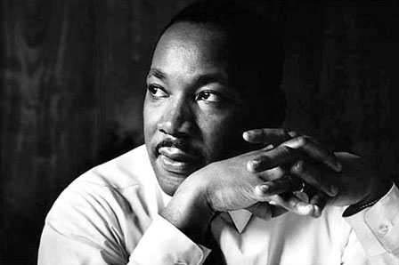

Slide 10
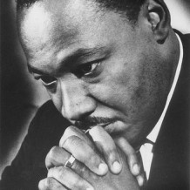
man of
Faith

Slide 11
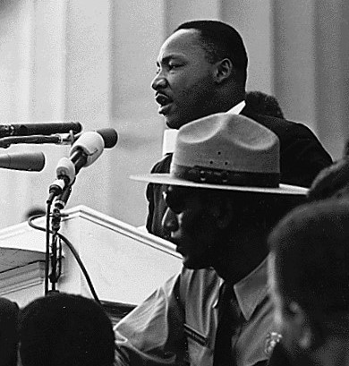
Speechmaker

Slide 12
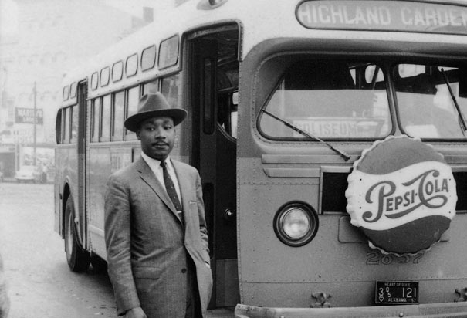
Civil
Rights
Leader

Slide 13
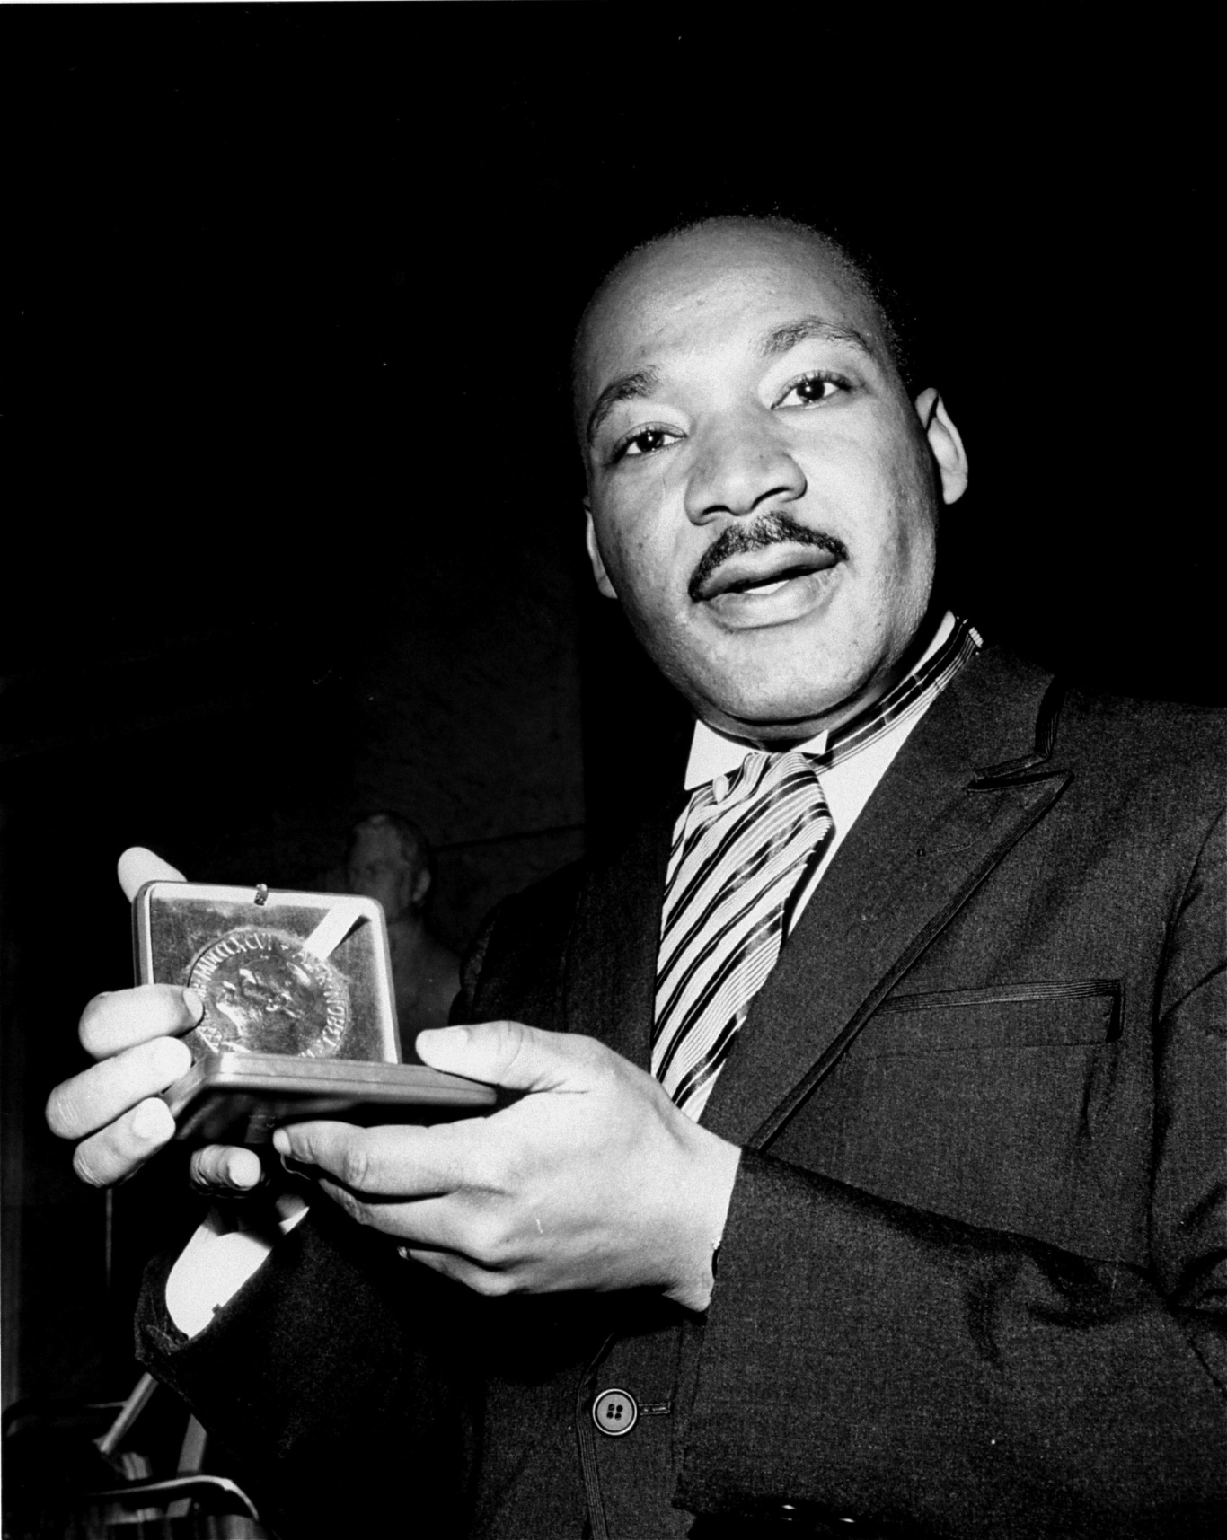
African
American
Legend

Slide 14
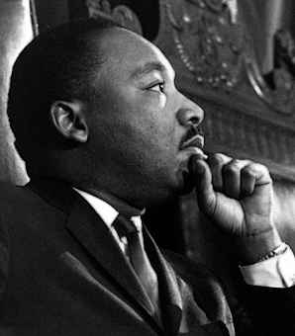
American
Hero

Slide 15
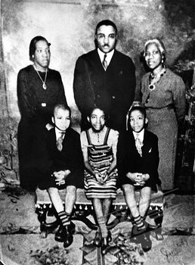
Born in 1929
& raised in
Atlanta, Martin was one of three children born to a Baptist preacher.

Slide 17
King became a leader in the civil rights movement in 1955, when he was invited to be a spokesperson for the Montgomery Bus Boycott.

Slide 19
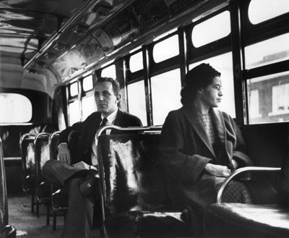
You may recall that the Montgomery Bus Boycott was initiated by another icon of the Civil Rights Movement, Rosa Parks who refused to sit at the back of the bus.

Slide 21
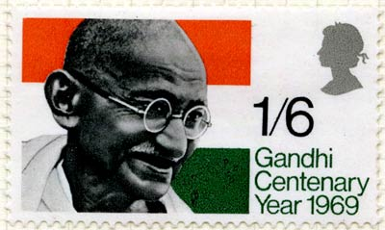
One of King’s greatest influences in his philosophy of non-violence was the teachings of Mahatma Gandhi, the father of modern India

Slide 22
I Have
a Dream

Slide 23
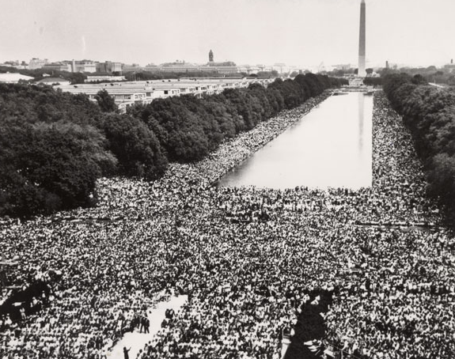
His most famous speech was given at the 1963 “March on Washington”

Slide 26
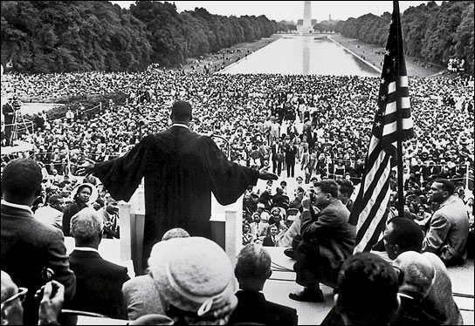

Slide 27
In 1964, King won the Nobel Peace Prize

Slide 29
Tragedy strikes on April 4, 1968

Slide 30
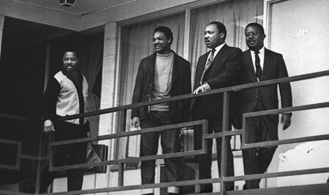
While standing on the balcony of his motel in Memphis, King was assassinated

Slide 32
Though gone…
Martin Luther King Jr. created a legacy of peace that guided the civil rights movement towards equality
in American society.

Slide 33
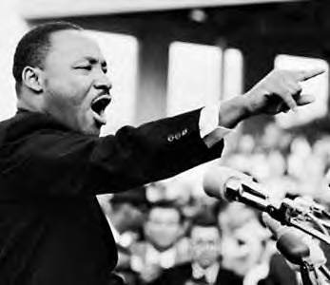

Slide 34
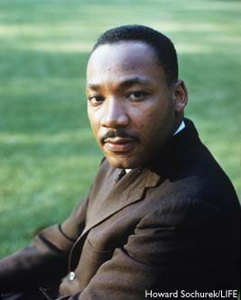
MLK 1929 - 1968
Don’t let the dream die.

Slide 35
Research Sources
http://www.thekingcenter.org/
Image Credits
http://itthing.com/wp-content/uploads/2.jpg
http://www.achievement.org/achievers/par0/large/par0-004.jpg
http://postalheritage.files.wordpress.com/2011/03/64-gandhi.jpg?w=400&h=239
http://a.abcnews.com/images/US/gty_martin_luther_king_speech_lincoln_memorial_mw_110822_wg.jpg
http://www.pbs.org/newshour/rundown/march-on-washington1.jpg
http://www.findingdulcinea.com/docroot/dulcinea/fd_images/news/on-this-day/March-April-08/On-this-Day--Martin-Luther-King-Jr--Assassinated-in-Memphis/news/0/image.jpg
http://www.infamouskidd.com/wp-content/uploads/2011/04/martin-luther-king-jr.jpg
http://www.history.com/images/media/slideshow/martin-luther-king-jr/mlk-montgomery-bus-boycott.jpg
http://www.lexington1.net/technology/instruct/lessons/elementary/mlking/king_files/mlk.jpg
http://myhero.com/images/guest/g20749/hero28812/mlkj.jpg
Audio Credit
http://www.americanrhetoric.com/speeches/mlkihaveadream.htm

Slide 36
NOW….
As you make your presentation…
Remember what you learned & make a GREAT presentation.

